Slide 1
Objectives
In this session, you will learn to:
  Query data by using joins
  Query data by using subqueries

Slide 2

Using an Equi Join
Equi join:
  Is the same as an inner join and joins tables with the help of a foreign key.
  Is used to display all the columns from both the tables.
Let us now understand the working of an equi join.
Notes:
Student already have learnt about type 2 SCDs in Module I. Therefore, you can start this topic by asking the following questions to students:
What are type 2 SCDs?
Given an example to explain type 2 SCDs.
This will recapitulate what they have learnt about type 2 SCD in Module 1.
Now explain the strategy to update the data into these dimension tables with help the example given in SG.
After explaining the examples, you can ask students to think of an example of a type 2 SCD and then tell the strategy to update the data into this dimension table.

Slide 3
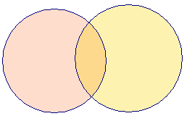
Using an Equi Join (Contd.)
COLUMNS
COLUMNS
    A B C
    B D E
    Table X
    Table Y
    EQUI JOIN
    A B C D B E
    COMMON ROWS
OUTPUT
Notes:
Explain the concept of EQUI join to the student.

Slide 4
Using an Equi Join (Contd.)
  For example:
    SELECT * FROM HumanResources.EmployeeDepartmentHistory d JOIN HumanResources.Employee e ON d.EmployeeID = e.EmployeeID JOIN HumanResources.Department p ON p.DepartmentID = d.DepartmentID
Notes:
Student already have learnt about type 2 SCDs in Module I. Therefore, you can start this topic by asking the following questions to students:
What are type 2 SCDs?
Given an example to explain type 2 SCDs.
This will recapitulate what they have learnt about type 2 SCD in Module 1.
Now explain the strategy to update the data into these dimension tables with help the example given in SG.
After explaining the examples, you can ask students to think of an example of a type 2 SCD and then tell the strategy to update the data into this dimension table.

Slide 5
Using an Equi Join (Contd.)
  For example:
    SELECT * FROM HumanResources.EmployeeDepartmentHistory d JOIN HumanResources.Employee e ON d.EmployeeID = e.EmployeeID JOIN HumanResources.Department p ON p.DepartmentID = d.DepartmentID
Applies an equi join between the EmployeeDepartmentHistory, Employee, and Department tables by using a common column, EmployeeID
Notes:
Student already have learnt about type 2 SCDs in Module I. Therefore, you can start this topic by asking the following questions to students:
What are type 2 SCDs?
Given an example to explain type 2 SCDs.
This will recapitulate what they have learnt about type 2 SCD in Module 1.
Now explain the strategy to update the data into these dimension tables with help the example given in SG.
After explaining the examples, you can ask students to think of an example of a type 2 SCD and then tell the strategy to update the data into this dimension table.

Slide 6
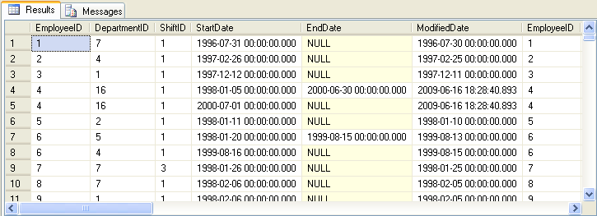
Using an Equi Join (Contd.)
  The following figure displays the output of the preceding query.
Displays the EmployeeID column from all the tables
Notes:
Student already have learnt about type 2 SCDs in Module I. Therefore, you can start this topic by asking the following questions to students:
What are type 2 SCDs?
Given an example to explain type 2 SCDs.
This will recapitulate what they have learnt about type 2 SCD in Module 1.
Now explain the strategy to update the data into these dimension tables with help the example given in SG.
After explaining the examples, you can ask students to think of an example of a type 2 SCD and then tell the strategy to update the data into this dimension table.

Slide 7
Just a minute
What is the difference between an equi join and an inner join?
Solution:
  An equi join is used to retrieve all the columns from both the tables. An inner join is used to retrieve selected columns from tables.
Notes:
Student already have learnt about type 2 SCDs in Module I. Therefore, you can start this topic by asking the following questions to students:
What are type 2 SCDs?
Given an example to explain type 2 SCDs.
This will recapitulate what they have learnt about type 2 SCD in Module 1.
Now explain the strategy to update the data into these dimension tables with help the example given in SG.
After explaining the examples, you can ask students to think of an example of a type 2 SCD and then tell the strategy to update the data into this dimension table.

Slide 8
Using a Self Join
Self join:
  A table is joined with itself.
  One row in a table correlates with other rows in the same table.
  A table name is used twice by giving two alias names in the query.
Notes:
Student already have learnt about type 2 SCDs in Module I. Therefore, you can start this topic by asking the following questions to students:
What are type 2 SCDs?
Given an example to explain type 2 SCDs.
This will recapitulate what they have learnt about type 2 SCD in Module 1.
Now explain the strategy to update the data into these dimension tables with help the example given in SG.
After explaining the examples, you can ask students to think of an example of a type 2 SCD and then tell the strategy to update the data into this dimension table.

Slide 9
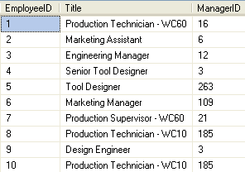
Using a Self Join (Contd.)
  Consider the Employee table, as shown in the following figure.
Notes:
Student already have learnt about type 2 SCDs in Module I. Therefore, you can start this topic by asking the following questions to students:
What are type 2 SCDs?
Given an example to explain type 2 SCDs.
This will recapitulate what they have learnt about type 2 SCD in Module 1.
Now explain the strategy to update the data into these dimension tables with help the example given in SG.
After explaining the examples, you can ask students to think of an example of a type 2 SCD and then tell the strategy to update the data into this dimension table.

Slide 10
Using a Self Join (Contd.)
To display the employee details along with their manager details, you can use a self join.

Slide 11
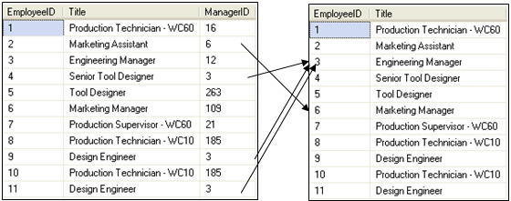
Using a Self Join (Contd.)
  To perform self-join, you need to divide the physical tables into two logical tables, as shown in the following figure.
Employee (emp)
Employee (mgr)
Emp.ManagerID = mgr.EmployeeID
Notes:
Student already have learnt about type 2 SCDs in Module I. Therefore, you can start this topic by asking the following questions to students:
What are type 2 SCDs?
Given an example to explain type 2 SCDs.
This will recapitulate what they have learnt about type 2 SCD in Module 1.
Now explain the strategy to update the data into these dimension tables with help the example given in SG.
After explaining the examples, you can ask students to think of an example of a type 2 SCD and then tell the strategy to update the data into this dimension table.

Slide 12
Using a Self Join (Contd.)
  The following query joins the Employee table with itself:
    SELECT emp.EmployeeID, emp.Title AS Employee_Designation, emp.ManagerID, mgr.Title AS Manager_Designation FROM HumanResources.Employee emp, HumanResources.Employee mgr WHERE emp.ManagerID = mgr.EmployeeID
Notes:
Student already have learnt about type 2 SCDs in Module I. Therefore, you can start this topic by asking the following questions to students:
What are type 2 SCDs?
Given an example to explain type 2 SCDs.
This will recapitulate what they have learnt about type 2 SCD in Module 1.
Now explain the strategy to update the data into these dimension tables with help the example given in SG.
After explaining the examples, you can ask students to think of an example of a type 2 SCD and then tell the strategy to update the data into this dimension table.

Slide 13
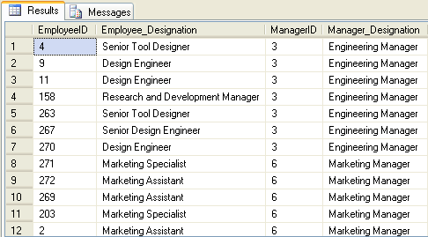
Using a Self Join (Contd.)
  The output of the preceding query is shown in the following figure.
Notes:
Student already have learnt about type 2 SCDs in Module I. Therefore, you can start this topic by asking the following questions to students:
What are type 2 SCDs?
Given an example to explain type 2 SCDs.
This will recapitulate what they have learnt about type 2 SCD in Module 1.
Now explain the strategy to update the data into these dimension tables with help the example given in SG.
After explaining the examples, you can ask students to think of an example of a type 2 SCD and then tell the strategy to update the data into this dimension table.

Slide 14
Demo: Using Joins
Problem Statement:
  The HR manager of AdventureWorks, Inc. requires a report containing the following details:
    Employee ID
    Employee Name
    Department Name
    Date of Joining
    EmployeeAddress
  How will you generate this report?
Notes:
You can summarize the session by running through the summary given in SG.
In addition, you can also ask students summarize what they have learnt in this session.

Slide 15
Demo: Using Joins (Contd.)
Solution:
  To solve the preceding problem, you need to perform the following tasks:
    1. Identify the join.
    2. Create a query based on joins.
    3. Execute the query to verify the result.
Notes:
You can summarize the session by running through the summary given in SG.
In addition, you can also ask students summarize what they have learnt in this session.

Slide 16
Querying Data by Using Subqueries
Subquery:
  Is an SQL statement that is used within another SQL statement.
  Is nested inside the WHERE or HAVING clause of the SELECT, INSERT, UPDATE, and DELETE statements.
  For example:
    SELECT * FROM EmployeeDetails
    WHERE Designation = (SELECT Designation FROM EmployeeDetails WHERE EmpName = 'John')
Notes:
You can summarize the session by running through the summary given in SG.
In addition, you can also ask students summarize what they have learnt in this session.

Slide 17
Querying Data by Using Subqueries (Contd.)
Subquery:
  Is an SQL statement that is used within another SQL statement.
  Is nested inside the WHERE or HAVING clause of the SELECT, INSERT, UPDATE, and DELETE statements.
  For example:
    SELECT * FROM EmployeeDetails
    WHERE Designation = (SELECT Designation FROM EmployeeDetails WHERE EmpName = 'John')
Represents the parent query and is called an outer query
Notes:
You can summarize the session by running through the summary given in SG.
In addition, you can also ask students summarize what they have learnt in this session.

Slide 18
Querying Data by Using Subqueries (Contd.)
Subquery:
  Is an SQL statement that is used within another SQL statement.
  Is nested inside the WHERE or HAVING clause of the SELECT, INSERT, UPDATE, and DELETE statements.
  For example:
    SELECT * FROM EmployeeDetails
    WHERE Designation = (SELECT Designation FROM EmployeeDetails WHERE EmpName = 'John')
Represents the subquery and is called an inner query
Notes:
You can summarize the session by running through the summary given in SG.
In addition, you can also ask students summarize what they have learnt in this session.

Slide 19
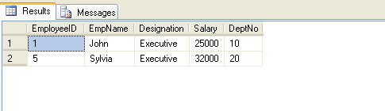
Querying Data by Using Subqueries (Contd.)
  The following figure displays the output of the preceding query.
Notes:
You can summarize the session by running through the summary given in SG.
In addition, you can also ask students summarize what they have learnt in this session.

Slide 20
Using the IN and EXISTS Keywords
You can specify different kinds of conditions on subqueries by using the following keywords:
  IN
  EXISTS
Notes:
You can summarize the session by running through the summary given in SG.
In addition, you can also ask students summarize what they have learnt in this session.

Slide 21
Using the IN and EXISTS Keywords (Contd.)
  IN keyword:
  Is used to retrieve rows in a subquery based on the match of values given in a list.
  Syntax:
    SELECT column, column [,column] FROM table_name WHERE column [ NOT ] IN ( SELECT column FROM table_name [WHERE conditional_expression] )
  For example:
    SELECT EmployeeID FROM HumanResources.EmployeeAddress WHERE AddressID IN (SELECT AddressID FROM Person.Address WHERE City = 'Bothell')
Notes:
You can summarize the session by running through the summary given in SG.
In addition, you can also ask students summarize what they have learnt in this session.

Slide 22
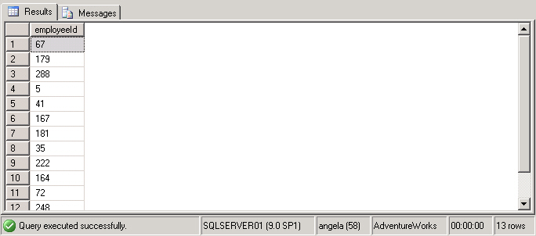
Using the IN and EXISTS Keywords (Contd.)
  The following figure displays the output of the preceding query.
Retrieves the EmployeeID attribute of all the employees, who live in Bothell, from the EmployeeAddress table
Notes:
You can summarize the session by running through the summary given in SG.
In addition, you can also ask students summarize what they have learnt in this session.

Slide 23
Using the IN and EXISTS Keywords (Contd.)
  EXISTS keyword:
  Is used to check the existence of the data and returns true or false.
  Syntax:
    SELECT column, column [,column] FROM table_name WHERE EXISTS ( SELECT column FROM table_name [ WHERE conditional_expression] )
  For example:
    SELECT EmployeeID, Title FROM HumanResources.Employee WHERE EXISTS (SELECT * FROM HumanResources.EmployeeDepartmentHistory WHERE EmployeeID = HumanResources.Employee.EmployeeID AND DepartmentID = 4)
Notes:
You can summarize the session by running through the summary given in SG.
In addition, you can also ask students summarize what they have learnt in this session.

Slide 24
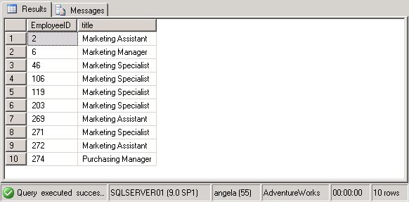
Using the IN and EXISTS Keywords (Contd.)
  The following figure displays the output of the preceding query.
Retrieves the employee Id and title of all the employees who have worked in the marketing department at any point of time
Notes:
You can summarize the session by running through the summary given in SG.
In addition, you can also ask students summarize what they have learnt in this session.

Slide 25
Summary
In this session, you learned that:
  An equi join is used to list all the columns from the joining tables.
  A self join correlates one row in a table with other rows in the same table.
  The IN clause in a subquery returns zero or more values.
  The EXISTS clause in a subquery returns data in terms of a TRUE or FALSE value.
Notes:
You can summarize the session by running through the summary given in SG.
In addition, you can also ask students summarize what they have learnt in this session.

